Slide 1

Predicting Youth Drug Use Risk Factors with Decision Trees and Ensemble Learning Machine Learning II
By Erdenetuya Namsrai
2025

Slide 2
Contents
Introduction
Theoretical Background
Methodology
Results
Discussion
Conclusion
Bibliography/References

Slide 3
Introduction
Objective: Investigate predictors of substance among youth
Dataset: National Survey on Drug Use and Health (NSDUH) /Youth Data, 2023 Variables include: Substance Use, Demographics, Youth Experience, and Mental Health
Tasks:
- Binary classification predict/ to predict youth marijuana and tobacco use
- Multi class classification/ to classify frequency of marijuana use
- Regression/ to predict age of first cigarette use
Models used: Tree Based Machine Learning Methods
- Decision Trees
- Pruned Tree
- Bagging
- Random Forest

Slide 4
Theoretical Background
Tree-based machine learning methods are used to study the factors influencing youth drug use, offering models that are easy to interpret
1. Decision Tree
- A decision tree classifies data by recursively splitting it into binary partitions based on feature values
- Hyperparameters: max_depth, min_samples_leaf, max_leaf_nodes
- Easy to understand and interpret
2. Bagging
- Creates many trees using random samples and combines their results to make better predictions
- Hyperparameters: ntree, mtry, nodesize, replace, maxnodes
Reduces Overfitting (Variance Reduction)

Slide 5
Theoretical Background
3. Random Forest
Similar to bagging, but at each tree split, only a random subset of features is considered instead of all features.
- Hyperparameters: ntree, mtry, nodesize, maxnodes
- Combines multiple decision trees to reduce overfitting and improve accuracy
4. Model Evaluation Metrics:
Classification: Accuracy, Precision, Recall, F1-Score, Confusion Matrix
Regression: Mean Squared Error (MSE) and Root Mean Squared Error (RMSE)

Slide 6
Methodology
Data Preprocessing
- Filtering youth experience features
- Removed missing values
- Feature Selection
- Categorical encoding
- Grouped multi-class label
Dataset:
- Training 70%
- Testing 30%
- Cross Validation (5-fold)
- Tuned Trees with Random Forest
Models:
- Decision Tree
- Pruned Decision Tree
- Bagging
- Random Forest
Tasks:
Binary Classification/ MRJFLAG and TOBFLAG
Multi-class Classification/ MRJYDAYS grouped
Regression/ IRCIGAGE

Slide 7
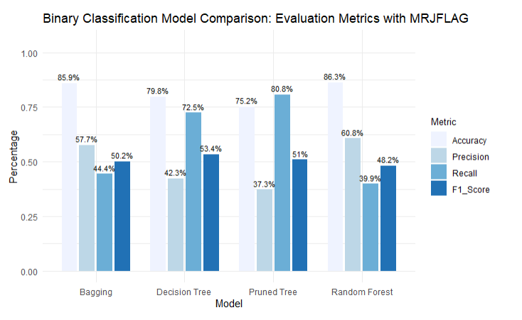
Results
Interpretation
Decision Tree found more positive cases (high
recall), but made more mistakes (low precision).
Bagging and Pruned Tree improved accuracy,
but still had a trade-off between precision and recall.
Random Forest gave the best balance, with high accuracy and precision, making it the most reliable model overall.

Slide 8
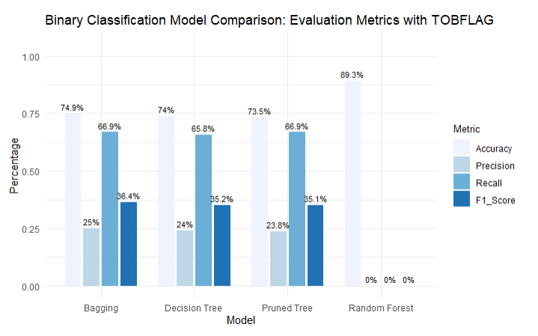
Results
Interpretation
Bagging, Decision Tree, and Pruned Tree found most positive cases (high recall), but made many mistakes (low precision).
All three had similar F1-Scores around 35%.
Random Forest had high accuracy but missed all positive cases — not reliable for this task.

Slide 9
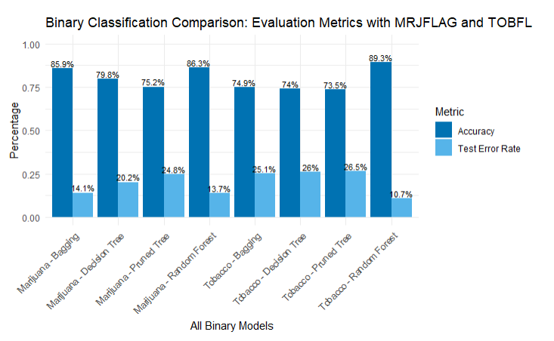
Results
Interpretation
Random Forest gave the best results for both Marijuana and Tobacco — highest accuracy, lowest error.
Bagging was also good, especially for Marijuana.
Decision Tree and Pruned Tree were less accurate.

Slide 10
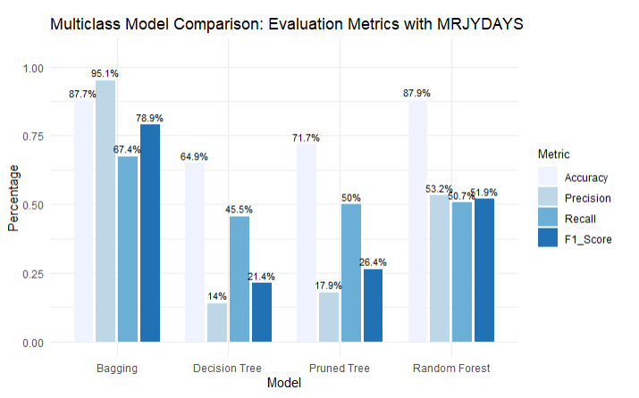
Results
Interpretation
Bagging performed best overall — highest accuracy, recall, and F1-Score.
Random Forest also did well, with balanced performance across all metrics.
Decision Tree and Pruned Tree had lower precision and recall, making them less reliable.

Slide 11
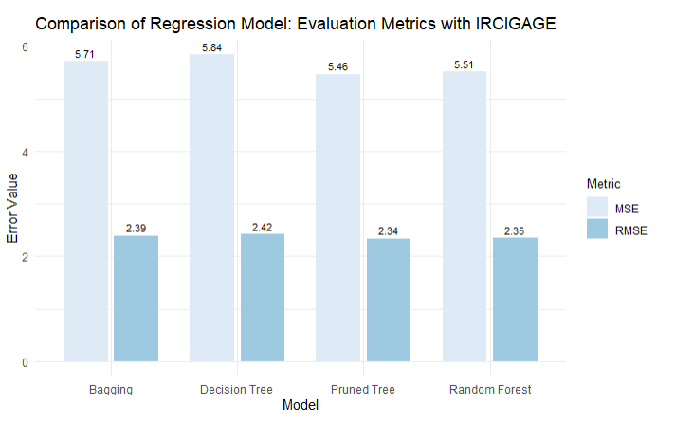
Results
Interpretation
Pruned Tree had the lowest error, so it's the best model.
Random Forest was a close second.
Bagging and Decision Tree had higher errors and were less accurate.

Slide 12
Discussion
Binary Classification
- Bagging and Random Forest performed best overall, with high accuracy and balanced F1-Scores.
- Decision Trees had strong recall, meaning they were effective at identifying positive cases useful for early intervention or prevention.
- Pruned Trees improved precision slightly over regular trees but still underperformed compared to ensemble methods.
- Random Forest was the most reliable across multiple binary tasks (MRJFLAG, TOBFLAG)
Multi-Class Challenges
- Most models struggled with class imbalance — especially underpredicting Light and Moderate classes.
- Heavy class dominated predictions, leading to biased performance across categories.
- Ensemble methods like Bagging and Random Forest helped improve balance, but did not fully resolve the issue.
- Performance in multi-class tasks can be improved with resampling techniques or class-aware losses.

Slide 13
Discussion
Regression Model Takeaways
- Pruned Tree showed the best overall performance with the lowest error, making it the most accurate model.
- Random Forest performed closely behind, with similarly low RMSE and MSE.
- Bagging and Decision Tree models had higher errors, indicating less reliable predictions.
Model Insights
-Tree-based models captured meaningful patterns related to age of first cigarette use (IRCIGAGE).
-Key features reflect peer influence and risk behavior (fighting, gun carrying, marijuana exposure).
Overall Improvements of Classification
- Explore advanced ensembling methods for better performance.
- Consider adding demographic or mental health features to strengthen prediction.

Slide 14
Conclusion
The most influential variables for youth substance:
The most influential variables for youth marijuana and tobacco use are:
- FRDMJMON (peer marijuana use)
- YFLADLY2 (youth risky behavior)
The most influential variables for predicting frequency of marijuana use (MRJYDAYS) are:
- STNDSMJ (attitude toward marijuana use – strong deterrent)
- YOSELL2 (drug selling – strong risk behavior)
The strongest predictors of earlier cigarette use (IRCIGAGE) are:
- Current/past use: YFLMJMO, YFLTMRJ2
- Peer influence: FRDMJMON, FRDMEVR2
These results show that youth substance use is strongly influenced by peer pressure, risky behaviors, and early exposure
Machine Learning Tree-based models provide clear interpretability and consistent performance
Youth behavior modeling is often hindered by class imbalance in the dataset.
Based on the findings of this study, there is strong potential to inform effective strategies for preventing and reducing drug use among youth.

Slide 15
Bibliography/References
James, G., Hastie, T., Witten, D., & Tibshirani, R. (2023). An Introduction to Statistical Learning with Applications in R (2nd ed.). Springer.
Substance Abuse and Mental Health Services Administration (SAMHSA). (2023). National Survey on Drug Use and Health (NSDUH), 2023 Public-Use Data Files. https://www.samhsa.gov/data/dataset/national-survey-drug-use-and-health-2023-nsduh-2023-ds0001
Substance Abuse and Mental Health Services Administration (SAMHSA). (2023). NSDUH 2023 Codebook. https://www.samhsa.gov/data/system/files/media-puf-file/NSDUH-2023-DS0001-info-codebook_v1.pdf
Mendible, J. (2023). Youth Dataset for DATA 5322 [GitHub repository]. https://github.com/mendible/5322/blob/main/Homework%201/youth_data.Rdata
R Core Team. (2023). R: A Language and Environment for Statistical Computing. R Foundation for Statistical Computing, Vienna, Austria. https://www.R-project.org/

Slide 16
Thank You for Your Attention!

